Slide 1
My 6th Grade Presentation of Learning
Core Value:
Perseverance & Responsibility
Enduring Understanding:Knowledge Causes Change
My Books
-Bud, Not Buddy
-Tears of a Tiger
My Personal Connections
By Student Name

Slide 2
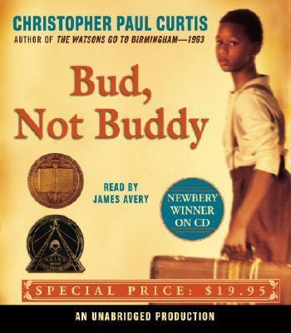
Bud, Not Buddy (My ELA Book)
Summary-This book I read in ELA by Christopher Paul Curtis is the story of a ten year old orphan named Bud who lives in several foster homes and winds up running away and making the 120 mile journey with only a suitcase to the Grand Rapids to find Herman Calloway. Fortunately he runs into Lefty Lewis along the way and they become friends. Lefty Lewis drives him the rest of the way to the Grand Rapids. When he gets there he seeks out Calloway at club where his band is performing and confronts him to tell him that he is his father. Calloway treats him harshly but allows him to live with him and come on the road with the band. Bud notices that his father has the same habit as his mother to write dates on rocks wherever he goes. He eventually figures out that his mother is actually Calloway’s daughter who ran away 11 years before!
Main Characters-Bud, Lefty Lewis, Herman Calloway

Slide 3
Tears of A Tiger (My Independent Reading Book)
Summary-This story by Sharon Draper is the story about how an adolescent copes with one bad decision that changes his life. After a winning a game and going out to party Andy makes the decision to drive home drunk. He ends up running into a cement wall and crashing the car which becomes engulfed in flames. His friends B.J. and Tyrone survive but Robbie gets his legs stuck in the windshield and burns to death. After the death of Robbie, Andy blames himself and cannot get past his guilt and pain. While his other friends have managed to work through their grief and move on, Andy allows death to become the focus of his life. In the months that follow the accident, the lives of Andy and his friends are traced through a series of letters, articles, homework assignments, and dialogues, and it becomes clear that Tigers do indeed need to cry. Despite the efforts of his girlfriend Keisha and his psychologist Dr. Carrothers Andy decides to end his life because the pain is too great.
Main Characters- Andy, Robbie (Hazelwood Tiger), Dr. Carrothers (Andy’s psychologist), Keisha (Andy’s girlfriend)

Slide 4
Core Values in the Text: Respect & Responsibility
Bud, Not Buddy
Bud has shows responsibility by making it his mission to take care of himself and find out who is father is
Calloway shows a lack of perseverance by not performing his fatherly duties (although difficult since the father and son have been separated) when it’s his responsibility to Bud
Tears of A Tiger
Keisha shows responsibility because she realizes that it’s important for her to support Andy while he’s grieving and she is very patient with him
Dr. Carrothers shows respect for Andy and treats him like he would treat any of his patients even though Andy has made such a big mistake. He believes Andy still deserves to move on with his life

Slide 5
Enduring Understanding: Knowledge Causes Change
The 6th grade enduring understanding can be used to better explain my Presentation of Learning…

Slide 6
My Personal Connections & Takeaways
After reading Bud, Not Buddy, I realized it’s my responsibility in life to move forward when something doesn’t go my way. For example, when my parents got divorced I spent a long time wishing they were back together. I had to come to the realization that I could not control their behavior and that it was my responsibility as the oldest child to take care of siblings and myself. Bud takes care of himself and doesn’t allow his tough life living in orphanages hold him back.
After reading Tears of A Tiger, I wish Andy had more perseverance and did not give up even when times were hard. He could have used his counselor and friends to find a reason to live. I’m lucky to have people to turn to at SEED when I go through tough times.

Slide 7
My Collection of Evidence
The following items are in my folder of documents that demonstrate the core values that I have shown this year
Writing assignment
Art project
Science lab
Etc.

Slide 8
Thank you for watching…. My 6th Grade Presentation of Learning!
A Special Thanks To….
My Advisor
My Teachers
My Counselor
…who made this all possible!

