Slide 1
My 10th Grade Presentation of Learning
Core Value:
Time is relative.
Enduring Understanding:
Systems create meaning.
My Sources
-In Cold Blood
selection
-Catch 22
-AP Government
-Conceptual
Physics
My Personal Connections
Service Learning Project
By Student Name

Slide 2
My ELA Book
Summary:
Main Characters-

Slide 3
My Independent book
Summary-
Main Characters-

Slide 4
My Independent book
Summary-
Main Characters-

Slide 5
My AP Government Project
(Students debated the pros and cons of a variety of public policy issues. In this space they can insert a video clip, if they recorded the debate, describe the debate, or insert their debate speech. Students need MLA citations if they use other sources in this space.)

Slide 6
My Conceptual Physics Project

Slide 7
Core Values in the Text and Projects: Respect & Responsibility
ELA BOOK
….
Independent Reading Book
….

Slide 8
Core Values in the Text and Projects (cont.) Respect & Responsibility
AP Government
Conceptual Physics

Slide 9
Core Values in the Text and Projects (cont.) Respect & Responsibility
Geometry
(connection to core values goes here)
AP English Language and Composition
(connection to core values goes here)

Slide 10
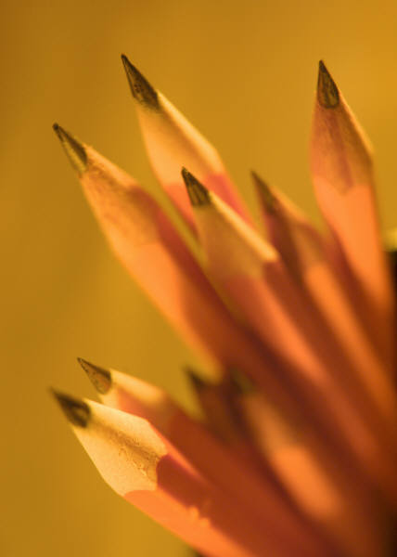
Enduring Understanding: Time is relative
ELA connection
Example 1:

Slide 11
Enduring Understanding: Time is relative (cont.)
AP Government
Example 1:

Slide 12
Enduring Understanding: Time is relative (cont.)
Conceptual Physics:
Physics

Slide 13
Enduring Understanding: Time is Relative (cont.)
Geometry
Example of EU for geometry goes here

Slide 14
Enduring Understanding: Time is Relative (cont.)
AP English Language and Composition

Slide 15
My Personal Connections & Takeaways
The student’s personal connections and AHA’s! go here.

Slide 16
Service Learning Project
Connection to core value

Slide 17
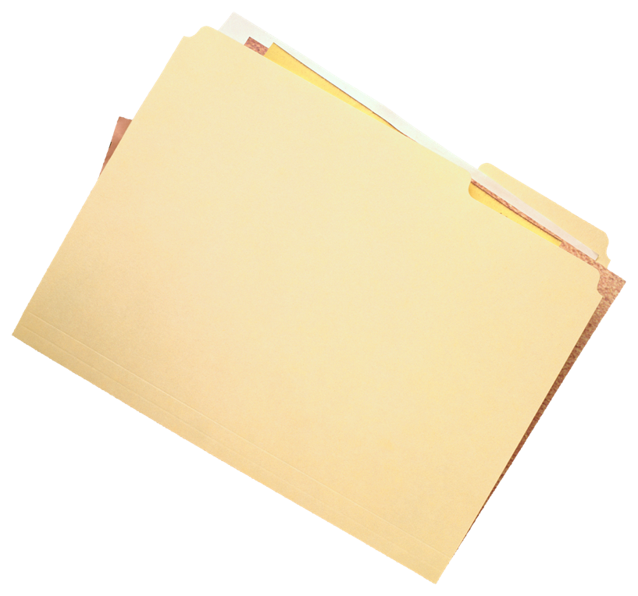
My Collection of Evidence
The following items are in my folder of documents that demonstrate the core values that I have shown this year (Below are examples of possible items of evidence).
Service Learning Project
Writing assignment
Art project
Science lab
Etc.

Slide 18
Thank you for watching…. My 10th Grade Presentation of Learning!
A Special Thanks To….
My Advisor
My Teachers
My Counselor
…who made this all possible!

